Slide 1


NEXT GEN EMPLOYABILITY PROGRAM
CREATING A FUTURE-READY WORKFORCE
Student Name :
VINAYAK GODI
College Name :
Student ID :
Nagarjuna College of Engineering And Technology
STU641c602b745f41679581227

Slide 2
CAPSTONE PROJECT SHOWCASE
Project Title
Car Rentals Application with Django Framework (FSWD)
Abstract | Problem Statement | Project Overview | Proposed Solution | Technology Used | Modelling & Results | Conclusion | Q&A

Slide 3
Abstract
1
"Our Car Rental service website designed to facilitate easy vehicle booking and management .User-friendly interface for browsing and booking vehicles."
2
"Secure user authentication and profile management system .Comprehensive admin dashboard for managing vehicle listings, bookings, and user accounts."
3
"Individuals seeking reliable and convenient transportation options for personal or business use Tourists exploring new destinations and in need of rental vehicles ."
4
"To streamline booking process with intiuitive user interfaces and efficient backend management"

Slide 4


Problem Statement
Develop a web-based car rental application using Django Framework (Full Stack Web Development). The application should allow users to browse and rent cars from a catalog, manage their rental bookings, and administer the system as an admin user.
The car rental industry is growing rapidly, with an increasing number of customers seeking convenient and efficient ways to rent vehicles for various purposes such as travel, business, and leisure. However, managing a car rental business involves numerous challenges such as inventory tracking, customer bookings, vehicle maintenance, and billing. Traditional methods of managing these tasks manually or through disjointed systems can lead to inefficiencies, errors, and customer dissatisfaction.

Slide 5

Project Overview
The Car Rentals Application is a web-based platform developed using the Django Framework (FSWD) to facilitate efficient and convenient vehicle rentals for customers while enabling administrators to manage the rental business seamlessly. The application includes essential features such as user registration, vehicle inventory management, booking and reservation system, admin dashboard, payment gateway integration, notifications, feedback system, and reporting tools.
Customers can register, log in, and browse available vehicles based on their preferences and needs. They can make bookings, receive confirmation notifications, and manage their reservations through the user-friendly interface. Payment processing is integrated securely, allowing customers to complete transactions online.
Administrators have access to a comprehensive dashboard where they can oversee bookings, manage inventory, track maintenance schedules, add or remove vehicles, and generate reports for business analysis. Automated notifications keep users informed about their rental status, upcoming bookings, and other relevant updates.

Slide 6
Proposed Solution
To address the challenges faced by the car rental industry and provide a comprehensive solution, we propose developing a Car Rentals Application using the Django Framework (FSWD). The application will incorporate the following key components and functionalities:
User Management System:
Allow customers to register, log in, and manage their profiles securely.
Implement authentication mechanisms to ensure user data privacy and security.
Vehicle Inventory Management:
Maintain a centralized database to store details of available vehicles, including make, model, year, mileage, and rental rates.
Enable administrators to add, edit, and remove vehicles as needed.
Booking and Reservation System:
Facilitate the booking process with real-time availability checks and confirmation notifications.
Allow customers to manage their bookings, including modifications and cancellations.
Admin Dashboard:
Provide administrators with a dashboard to monitor bookings, track inventory levels, view upcoming reservations, and manage rental schedules.
Implement reporting tools to generate insights into revenue, customer trends, and operational performance.
Payment Gateway Integration:
Integrate a secure payment gateway to enable customers to make online payments for bookings.
Support multiple payment methods for flexibility and convenience.

Slide 7
Technology used
The proposed Car Rentals Application with the Django Framework (FSWD) will leverage a combination of technologies to ensure a robust, scalable, and secure solution. Here are the key technologies that will be used:
Django Framework: Django is a high-level Python web framework that promotes rapid development, clean design, and scalability. It provides built-in features for handling user authentication, database management, URL routing, and template rendering, making it well-suited for developing complex web applications like the Car Rentals Application.
Python Programming Language: Python will be used as the primary programming language for backend development within the Django framework. Python's simplicity, readability, and extensive libraries make it ideal for developing web applications with efficient code.
HTML/CSS/JavaScript (Frontend): For the frontend user interface, HTML will be used for structure, CSS for styling, and JavaScript for interactive elements and client-side functionality. Frontend frameworks like Bootstrap or Tailwind CSS may also be utilized for responsive design and enhanced UI components.
Database Management System (DBMS): The application will use a relational database management system (RDBMS) to store and manage data efficiently. PostgreSQL or MySQL/MariaDB are popular choices for Django projects due to their robustness and compatibility with the Django ORM (Object-Relational Mapping).
Payment Gateway Integration: A secure and reliable payment gateway will be integrated into the application to facilitate online payments for bookings. Common payment gateways include Stripe, PayPal, or Braintree, which offer APIs for seamless integration and transaction processing.

Slide 8
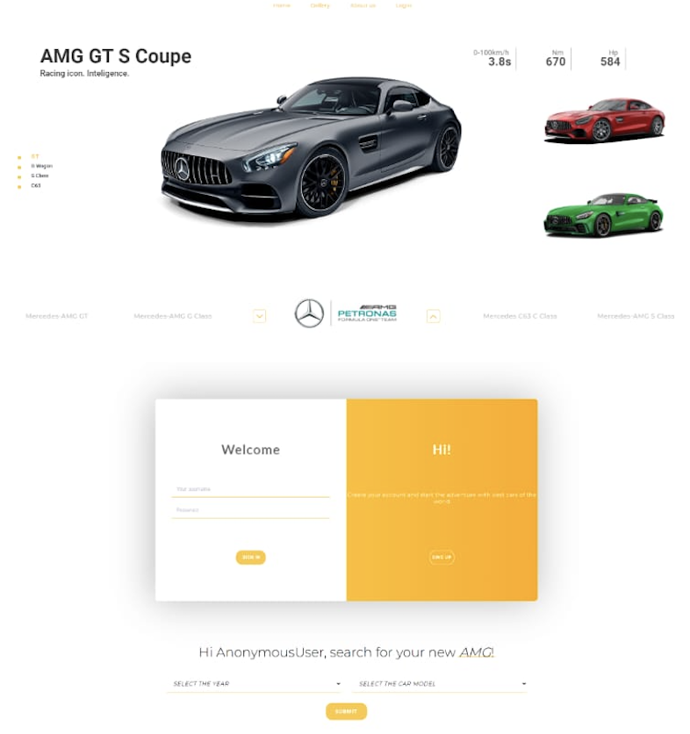
Modelling & Result

Slide 9
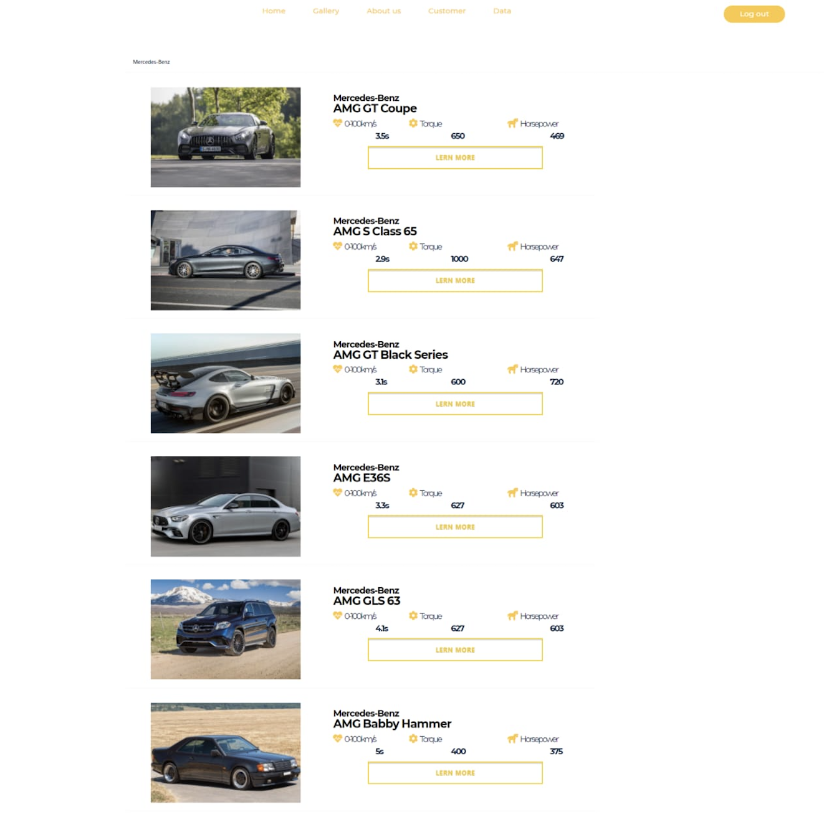
Modelling & Result

Slide 10
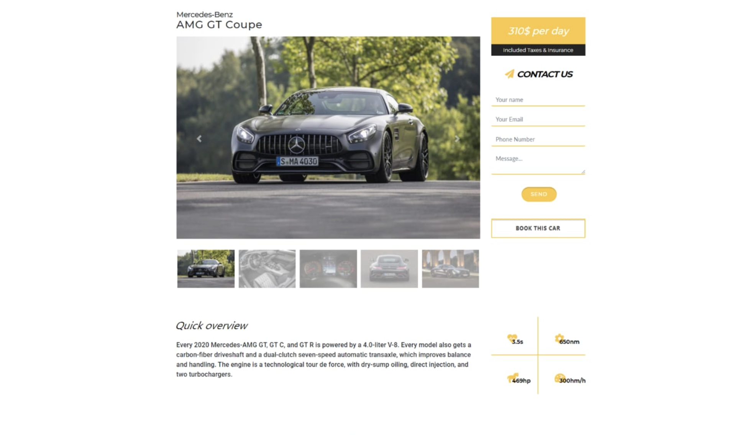
Modelling & Result

Slide 11

Conclusion
Our Car Rental Service website, built using the Django framework and a range of modern technologies, offers a comprehensive solution to the challenges faced in the car rental industry. By prioritizing user experience, security, and efficiency, we have developed a platform that simplifies the vehicle rental process for users while providing rental companies with the tools they need to streamline operations and enhance productivity. Through intuitive interfaces, robust backend management, and secure payment integration, our website sets new standards in convenience, reliability, and trustworthiness. With a scalable architecture and a commitment to ongoing improvement, we are poised to revolutionize the way people rent vehicles, making it easier, faster, and more enjoyable for all parties involved.

Slide 12


Notes:
Thank You !!

